Slide 1
Meta Heuristic Optimization
Chathura Rajapakse Dr.Eng.
Department of Industrial Management
Faculty of Science
University of Kelaniya

Slide 2
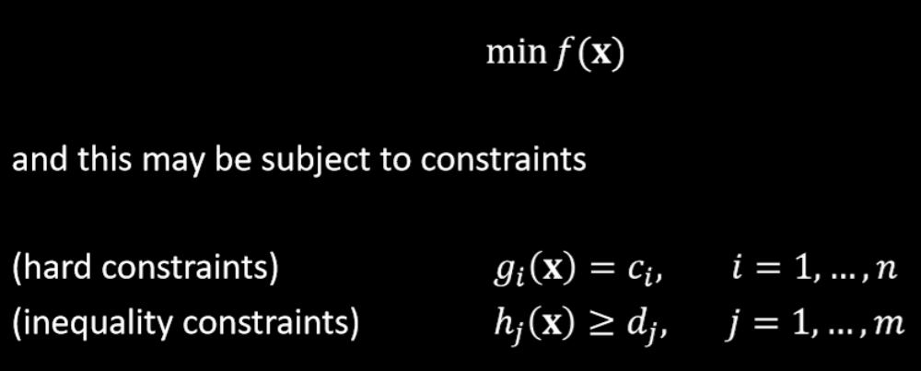
Objective Function
Optimization problems can be approximated to a mathematical function called objective function
Ex.

Slide 3
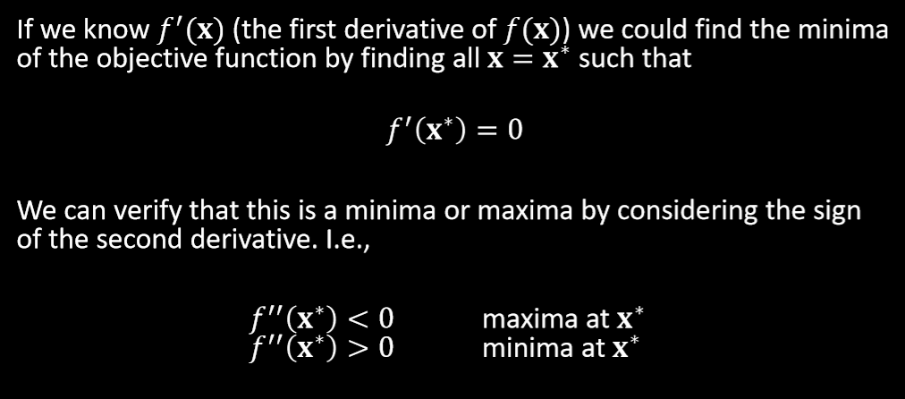
Mathematical formulation

Slide 4
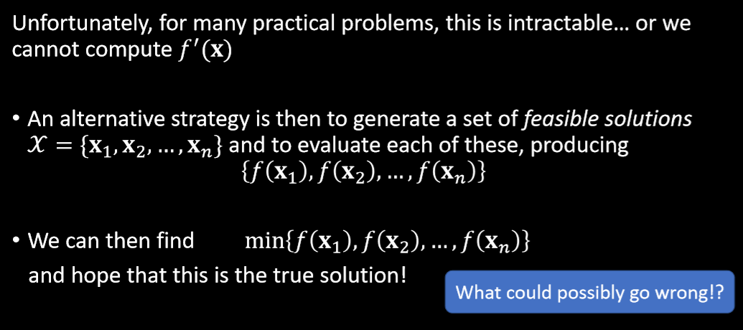
Mathematical formulation

Slide 5
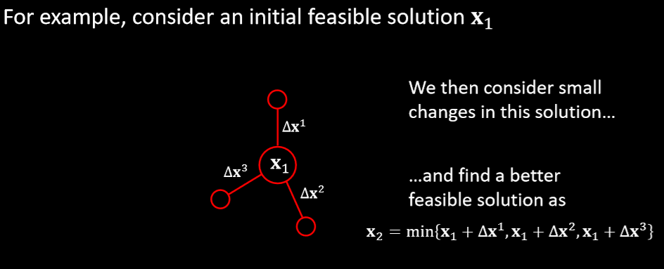
Gradient descent (Hill climbing)

Slide 6
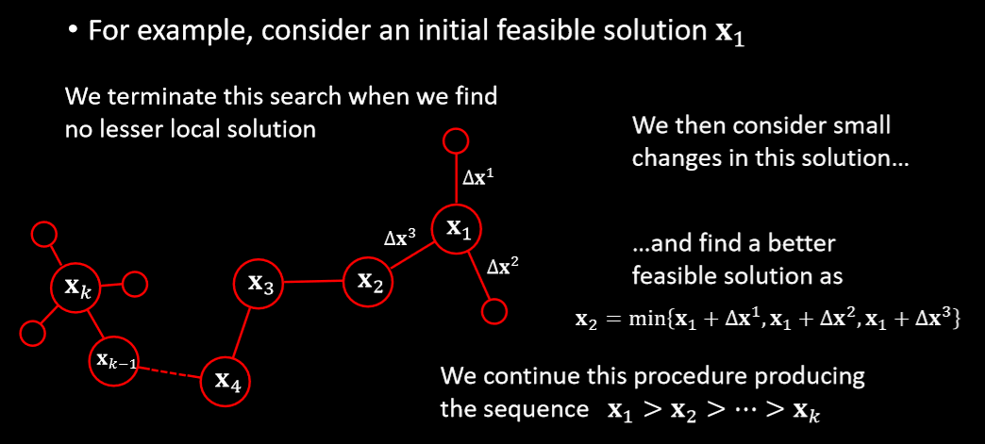
Gradient descent (hill climbing)

Slide 7
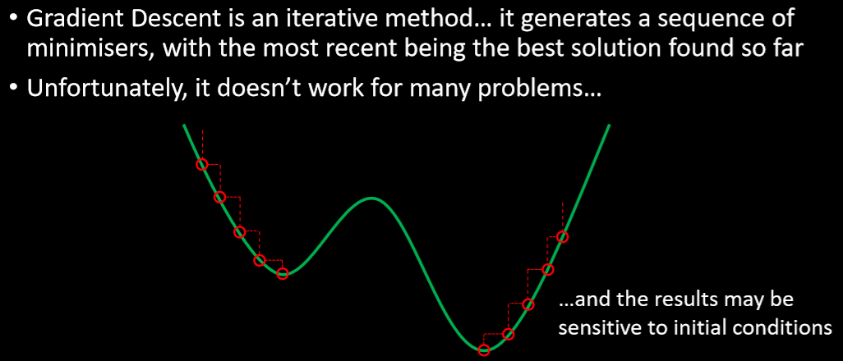
Gradient descent (hill climbing)

Slide 8
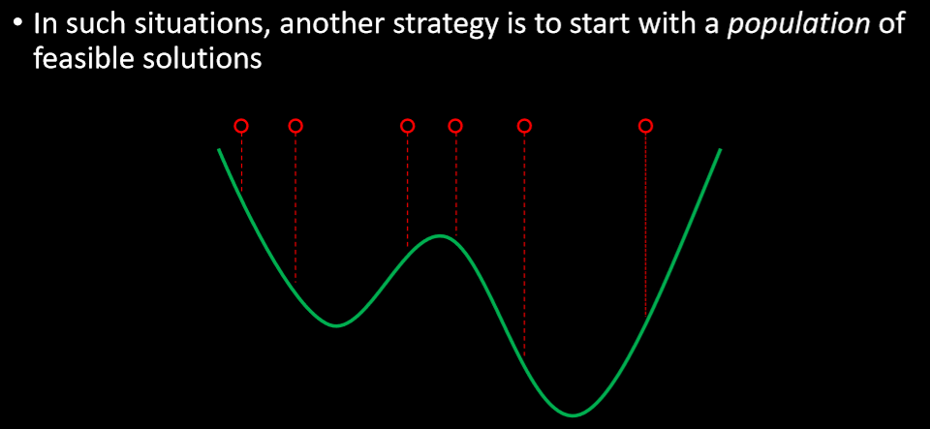
Meta heuristic optimization

Slide 9
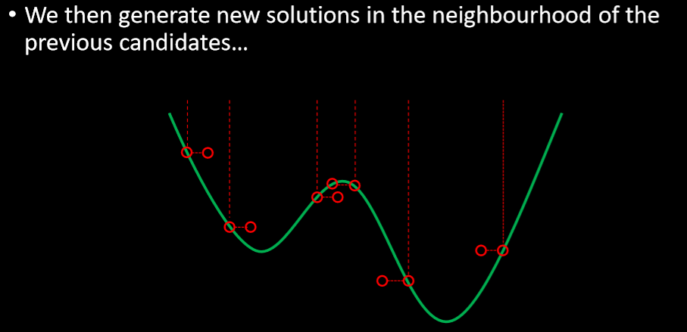
Meta heuristic optimization

Slide 10
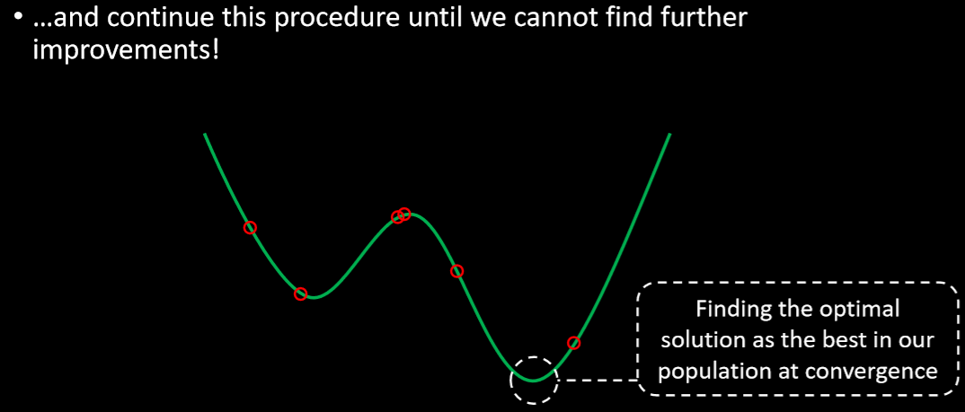
Meta heuristic optimization

Slide 11
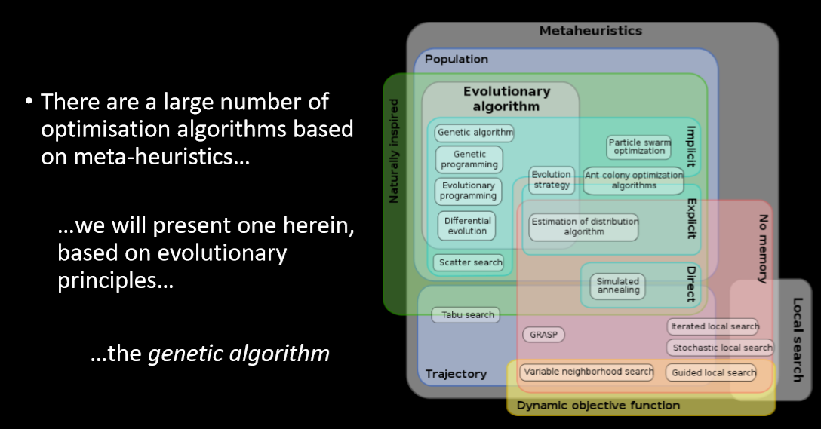
Scope of meta-heuristics

Slide 12
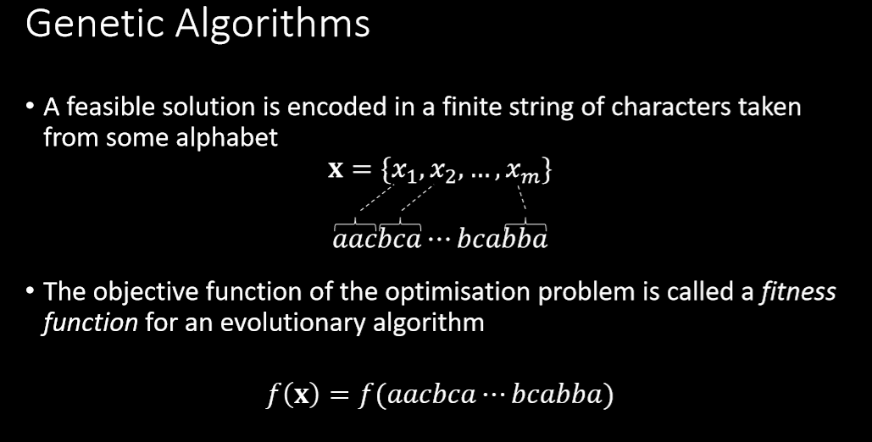

Slide 13
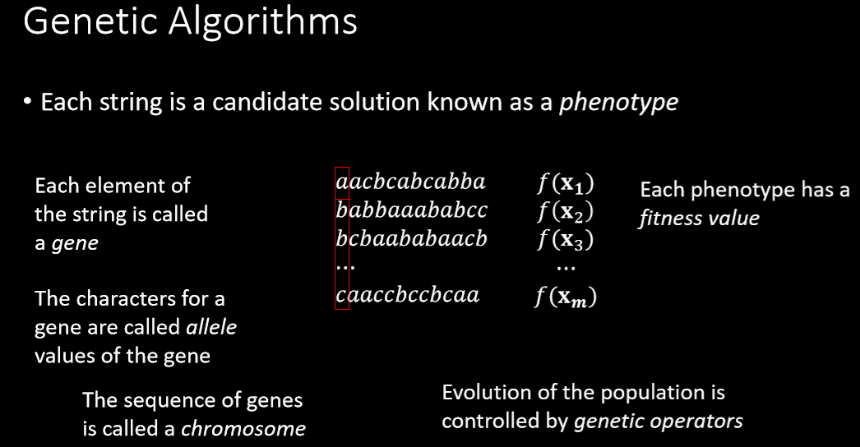

Slide 14
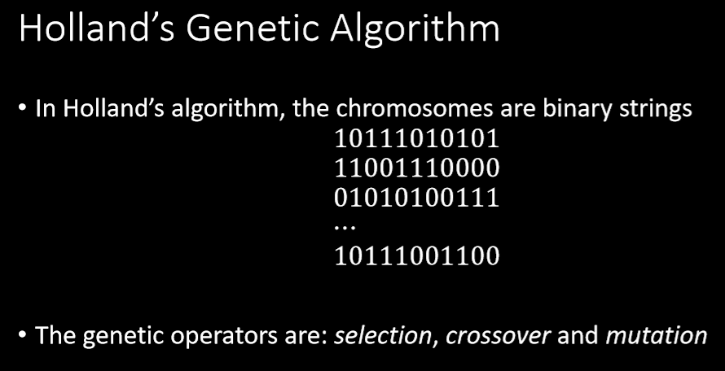

Slide 15
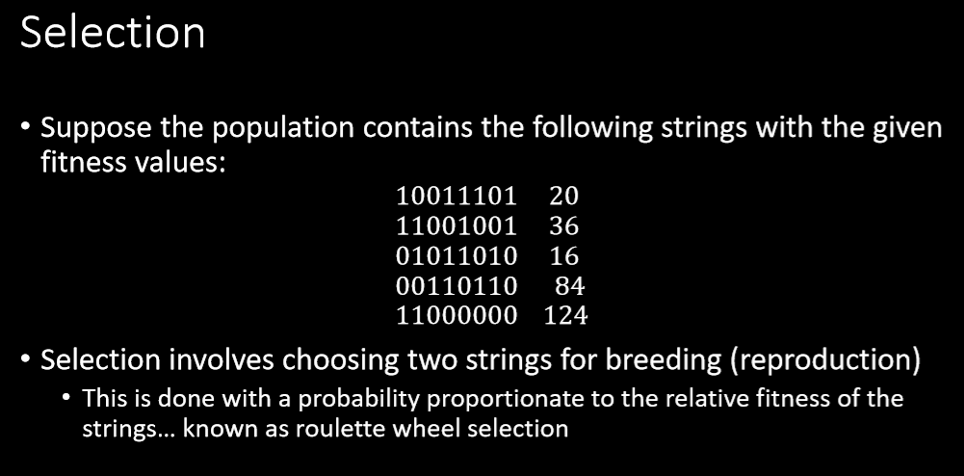

Slide 16
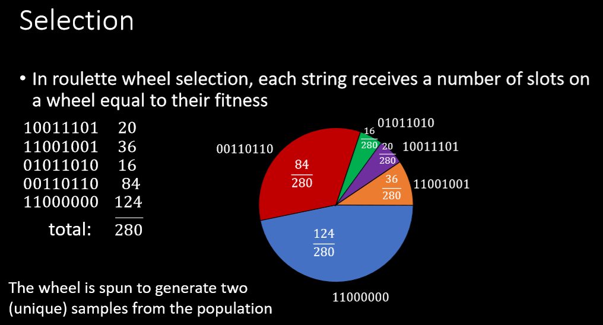

Slide 17
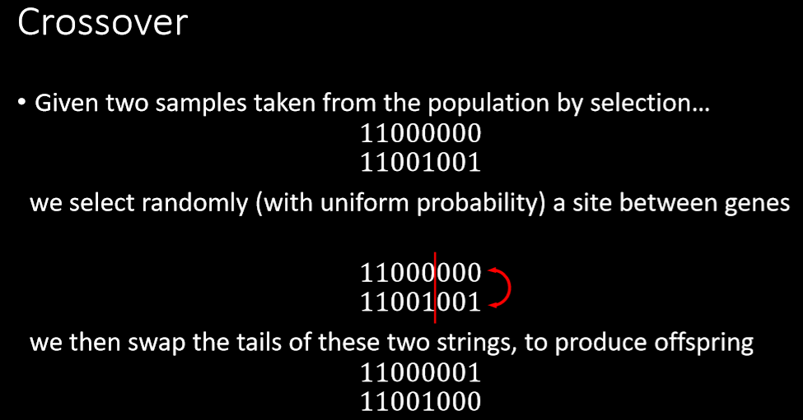

Slide 18
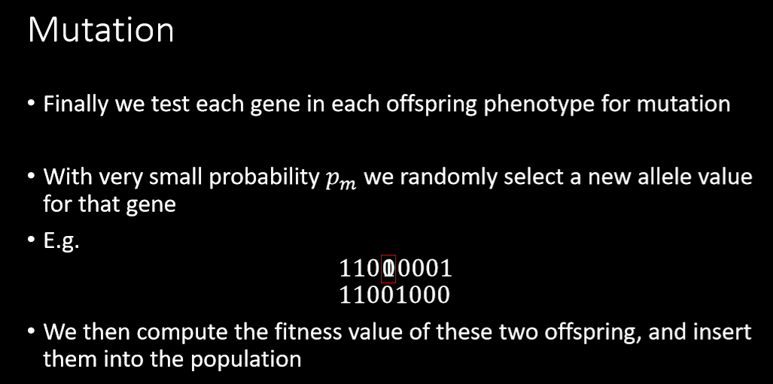

Slide 19
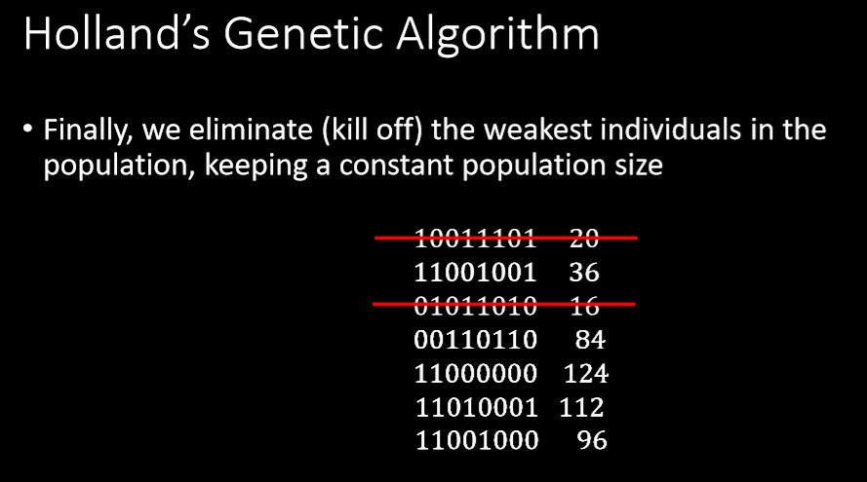

Slide 20
Termination of a GA
The generational process is repeated until a termination condition has been reached.
Common terminating conditions are:
  A solution is found that satisfies minimum criteria
  Fixed number of generations reached
  Allocated budget (computation time/money) reached
  The highest ranking solution's fitness is reaching or has reached a plateau such that successive iterations no longer produce better results
  Manual inspection
  Any Combinations of the above

Slide 21
Exercise 01
Suppose you need to find the maximum x² given 0 <= x < 32.
  Write the objective function
  Generate four phenotypes
  Complete one iteration by hand

Slide 22
Exercise 01
f(x) = {MAX(x²): 0 < x < 32 }
Encode Solution: Just use 5 bits (1 or 0).
Generate initial population.
Evaluate each solution against objective.
A | 0 | 1 | 1 | 0 | 1
B | 1 | 1 | 0 | 0 | 0
C | 0 | 1 | 0 | 0 | 0
D | 1 | 0 | 0 | 1 | 1
Sol. | String | Fitness | % of Total
A | 01101 | 169 | 14.4
B | 11000 | 576 | 49.2
C | 01000 | 64 | 5.5
D | 10011 | 361 | 30.9

Slide 23
Exercise 01 contd’
Create next generation of solutions
  Probability of “being a parent” depends on the fitness.
Ways for parents to create next generation
  Reproduction
    Use a string again unmodified.
  Crossover
    Cut and paste portions of one string to another.
  Mutation
    Randomly flip a bit.
  COMBINATION of all of the above.

Slide 24
Exercise 02
Consider the Traveling Salesman Problem with 7 cities
  Formulate a chromosome
  Hand-execute one iteration for 10 number of chromosomes
What problems did you encounter?
How do you think you can solve them?

Slide 25
Random Keys Algorithm
Consider a TSP example with 5 cities
  How to represent a solution?
    (4 2 1 5 3)
    Path: 3 -> 2 -> 5 -> 1 -> 4
  Using one-point crossover is difficult
    Ex:
      Parents: (1 4 3 2 5), (2 4 5 3 1)
      Children: (1 4 3 3 1), (2 4 5 1 4)
    Random Key method: An alternative

Slide 26


Random key method
Assign a random number drawn uniformly from (0, 1)
  Decode in ascending order (could use descending as well)
  Example:
    Path: 2 -> 3 -> 1 -> 4 -> 5
  Crossover operator:
    Different methods could be used
    Ex. Parameterized uniform crossover:
      Select two parents randomly inheriting each gene from parent 1 with probability p and from parent 2 with probability 1 – p

Slide 27
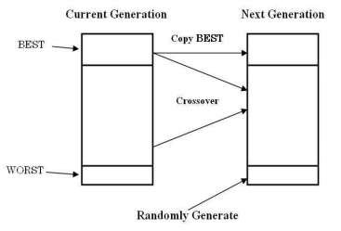
Random key method
Mutation operator
  Replace the worst set with a newly created set of candidates
    Randomly generate a new set of individuals – random key method is used
    Avoids pre-mature convergence
    Also called immigration

Slide 28
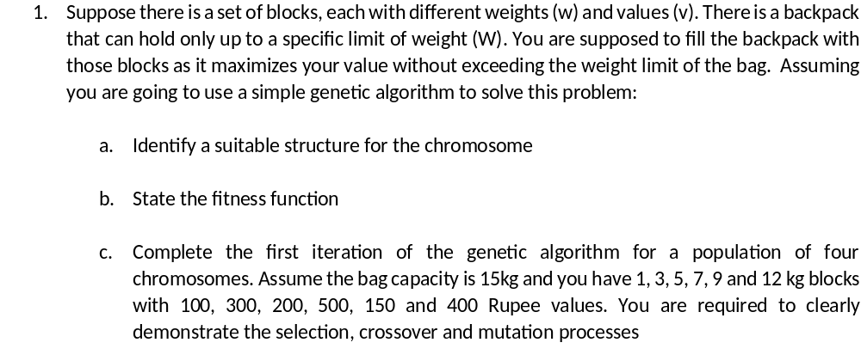
Exercise 01

Slide 29
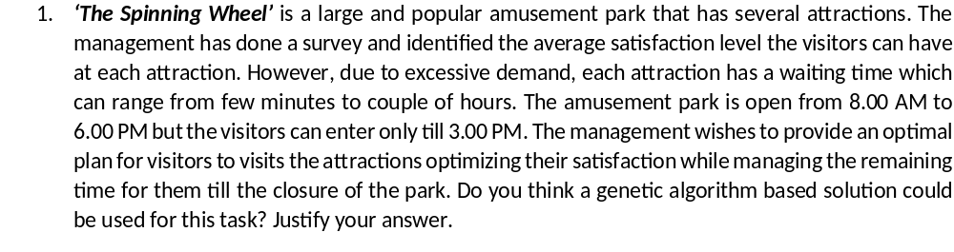
Exercise 02

Slide 30

Multi-objective Optimization
Involves more than one objective function
Ex:
Is it possible to solve this using GA? Give it a try.

